Slide 1
Mission 5 Remix
Create your own project from Mission 5

Slide 2

Warm-up
In your Mission 5 Remix Log, answer the pre-mission preparation questions:
What did you like about Mission 5?
What didn’t you like about Mission 5?

Slide 3

Time for a project remix!
A remix can be:
A new program created by adding new code to a program you already created
You can combine parts of two or more programs in a remix
Use a similar idea in a different way

Slide 4
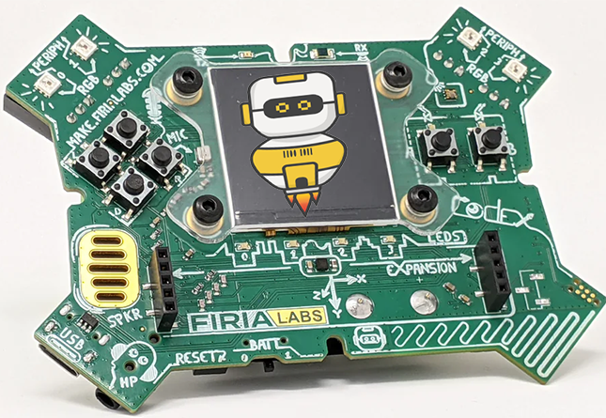
Project Remix
Creating a remix will let you:
Improve your skills and practice the concepts from the mission
Be creative
Remember code from earlier programs and missions
Work with other students
Design an original program and write the code all on your own

Slide 5
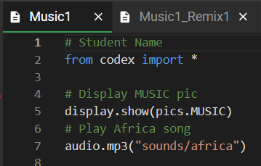
Step #1
Review the mission
Open your project from
Mission 5
  What does the program do?
  What skills were used or concepts learned?
DO THIS:
Fill out the information in the Mission 5 Remix Log for Step 1

Slide 6
Step #2
Brainstorm ideas
Read through remix suggestions from your teacher
Six suggestions are on the next 3 slides. You can use any of these ideas or come up with your own.

Slide 7

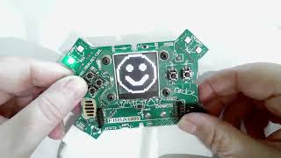
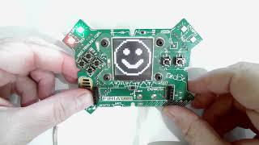
Step #2 Remix Ideas
Mild
Add a voice prompt for the game created in Mission 4 (Display). Either replace each display.print() and audibly prompt the user which button must be pressed, or include both the display and the audio.
Mild
Open the Mission 4 program (Display). Add an audio file to the if statements to indicate correct or wrong. You can use “okay” and “no” or any of the audio files.
Ctrl-Click on images to see videos

Slide 8
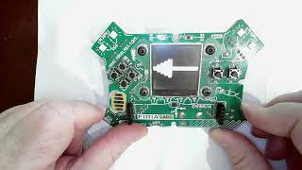
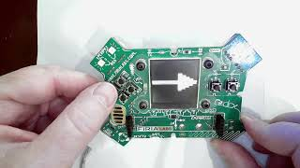
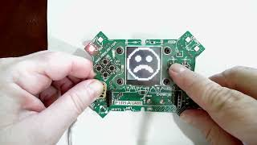
Step #2 Remix Ideas
Ctrl-Click on images to see videos
Medium
Program each button to do a different task. For example, BTN_A could light pixels and display an image. BTN_B could display an image and play audio. BTN_U could cause pixels to blink random colors. And so forth.
Medium
Create turn signals for a bicycle. Press button L to turn left, button R to turn right. Blink the pixels to indicate the turn, and use an audio file to say the direction you are turning.
EXTENSION: use a while True: loop to use the turn signals more than once.
while True:
if statement:
Indented code for left signal
if statement:
Indented code for right signal
* be careful with indenting
* you will need to physically stop the code
Ctrl-Click on images to see videos

Slide 9
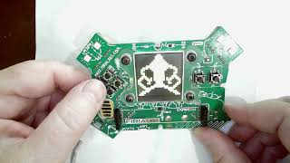
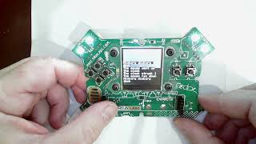
Step #2
Spicy
Combine the two mild remixes into one program -- audio prompt for the button and audio file for correct or wrong. Also, add print statements at the beginning for an intro and a print statement at the end.
Spicy
Program at least three buttons to display a short poem and play an audio file.
Ctrl-Click on images to see videos

Slide 10
Step #2
Brainstorm ideas
Read through remix suggestions from your teacher (previous slides)
Use your creativity to come up with your own idea for a project
Decide with your partner what project you will do
DO THIS:
Fill out the information in the Mission 5 Remix Log for Step #2

Slide 11
Step #3
Make a plan
What variables will you need?
  Note: you do not have to use a variable for this remix
What images will you display?
What audio files will you play?
DO THIS:
Fill out the information in the Mission 5 Remix Log for Step #3

Slide 12

Step #4
Code your project
IMPORTANT: Go to the sandbox to code the remix project
  Above toolbox in the lower left corner
Start with a new file and give it a descriptive name (Remix5)
You can leave Display and/or Music1 open (use them as a guide)
Import your modules
Define your variables
Write your code, testing frequently

Slide 13
Step #4
Stop and test frequently!
Don’t try to write all the code at one time
Mistakes happen, so find them early
Type just a few lines of code and then run the program
If there is an error, fix it before continuing
Use the debugger and your other programs for help

Slide 14
Step #5
Documentation!
Make sure your code is readable by adding blank lines
Add comments to sections of your code that explain what they do

Slide 15
Step #5
Get feedback
Show your code to other students
What do they think? Have them fill out the feedback form on your Mission 5 Remix Log
Give yourself some feedback Is there something you want to change or improve or add? Fill out the feedback form on your Mission 5 Remix Log
Modify your code to make your project even better

Slide 16

And now you have your own remix!
Congratulations!
By completing this remix you have:
learned more about programming
practiced the skills and concepts from the missions
been thinking! And problem solving and much more!

Slide 17
Mission Reflection
Wow! Great job!
Share your project with your friends!
Complete your Mission 5 Remix Log
Don’t forget to clear your CodeX by running your Clear program

